Slide 1

BMW Price Prediction
Using Machine Learning
Ahmed Nabil Allam, Epsilon AI

Slide 2

Project Overview
Predicting BMW Prices with ML
This project focuses on predicting BMW car prices from 2010 to 2026 using historical sales data and machine learning. It emphasizes the need for data-driven forecasting in the automotive industry.
PRESENTATION AGENDA
2

Slide 3
Project Objectives
Clarifying our main goals
Analyze Sales Data
We aim to systematically analyze sales data to identify critical pricing features, which will be key in training our prediction models and visualizing market trends effectively.
IMPORTANT CONSIDERATIONS
3

Slide 4

Dataset Overview
Key Features of the Dataset
The dataset comprises historical sales data from 2010 to 2024, featuring essential attributes such as Model, Year, Engine Size, and Mileage, which are crucial for accurate price predictions.
NOTES ON DATASET
4

Slide 5
Feature Engineering
Car Age
Mileage per Year
Calculating Car Age involves subtracting the manufacturing year from the current year, providing valuable insights into depreciation and market trends that influence BMW price predictions.
Mileage per Year is calculated by dividing total mileage by the car's age, offering critical data for assessing wear and tear, which significantly impacts pricing strategies for BMW vehicles.
KEY CONSIDERATIONS
5

Slide 6
Model Selection
Optimal Algorithms for Prediction
Random Forest & XGBoost
The Random Forest Regressor provides robustness against overfitting, while XGBoost Regressor enhances performance through gradient boosting, achieving higher accuracy in predicting BMW prices efficiently.
KEY CONSIDERATIONS
6

Slide 7

Data Split & Scaling
Efficiently Managing Data for Models
The dataset is split into training (80%) and testing (20%) sets, ensuring robust model performance while feature scaling is applied using StandardScaler to maintain consistent data ranges.
NOTES ON METHODOLOGY
7

Slide 8
0.91
0.93
Random Forest R² Score
XGBoost R² Score
This model achieved strong predictive capability in our analysis.
This model demonstrated even greater accuracy in predictions.
MODEL PERFORMANCE
8

Slide 9
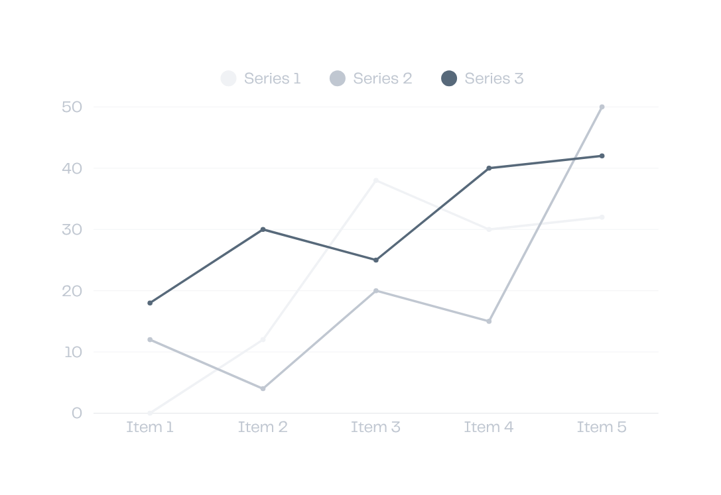
Future Price Trends
Analysis of predicted price stability and variations for BMW models from 2024 to 2026
The analysis indicates a stable to slightly increasing price trend influenced by engine size and mileage factors.
INSIGHTS AND OBSERVATIONS
9

Slide 10
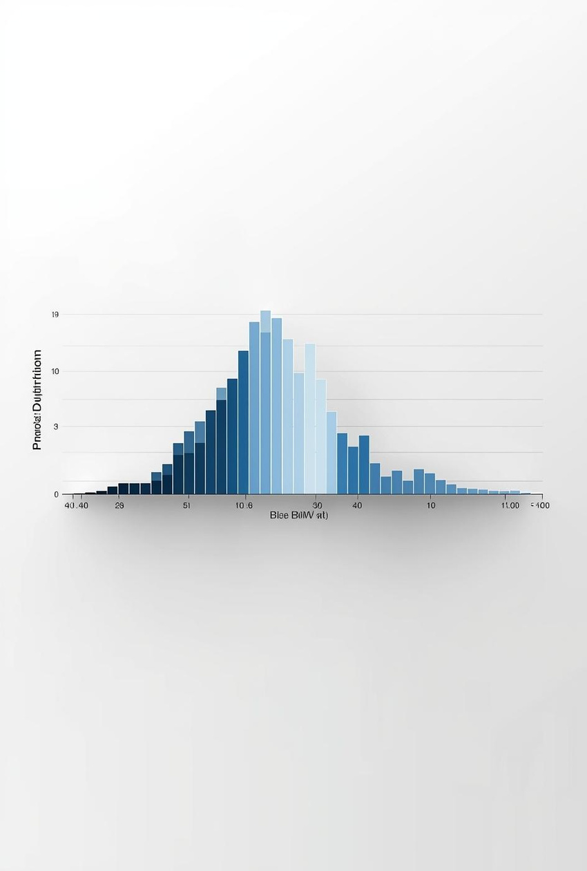
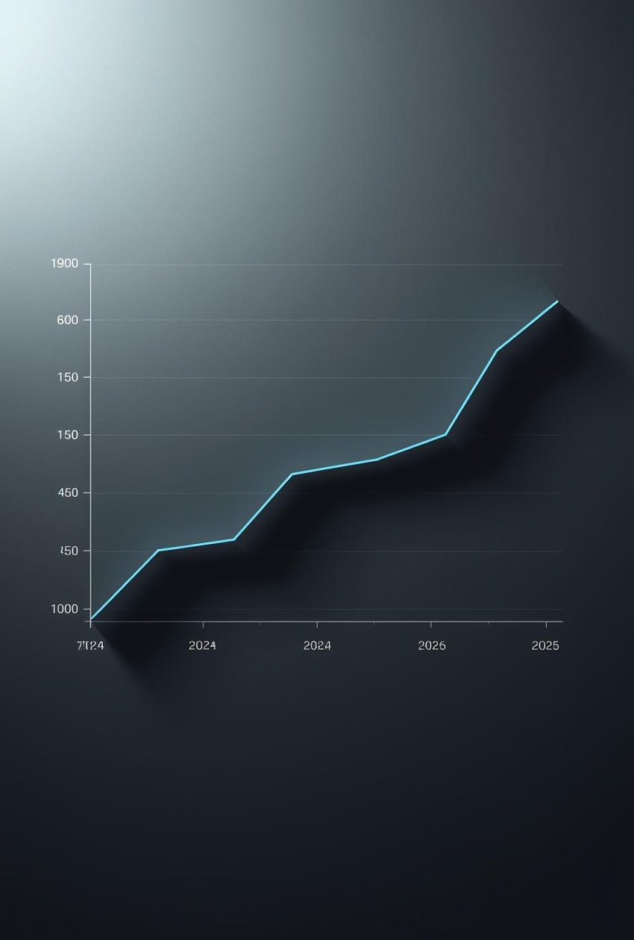
Interactive Charts
Visualizing Price Distribution and Trends
KEY OBSERVATIONS
10

Slide 11
Key Insights from Analysis
Price Determinants
Engine size and mileage significantly impact BMW pricing trends.
Price Growth
Moderate price increases observed from 2020 through 2026 data.
ML Effectiveness
Machine learning models show strong predictive power in forecasting.
ADDITIONAL INFORMATION
11

